Slide 1
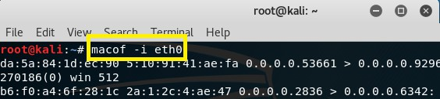
MAC Flooding Attack:
Now Macof can flood a switch with random MAC addresses. macof –i eth0
Port Security:
Port Security feature protect the switch from MAC flooding attacks.
Port security feature protect the switch from DHCP starvation attacks.
Attacker start flooding the switch with very large number of DHCP requests.
Port Security prevent unauthorized access & limit access, based on MAC address.
Port Security is disabled by default on every interface of Cisco Switch.
If Port Security is enabled by default only one MAC address is, allow per interface.
If Port Security is enabled by default, in Cisco Switches violation is shutdown.
If Port Security is enabled by default, no aging is configured for recovery.
Port Security can be configure Static, Dynamic and Sticky in Cisco Switches.
There are three different types of violation Shutdown, Protect and Restrict.
Port Security limit is (1-8192) MAC address to attach on particular port in Switch.
Port Security Violation Types:
There are three different types of violation Shutdown, Protect and Restrict.
Shutdown:
Default action after violation.
Port send to err-disabled mode.
For re-enable err-disabled recover, shutdown/no shutdown.
MAC counter keeps history.
Protect:
Need to configure for violation action.
Traffic does not send to network from violator.
Interface will be working even after violation.
No MAC counter keeps history.
Restrict:
Need to configure for violation action.
Traffic does not send to network from violator.
Generate log (SNMP/Syslog).
No MAC counter keeps history.

Slide 2
Violation Action | Description
Protect | Discards the bogus or extra MAC address without notifying the administrator.
Restrict | Discards the bogus or extra MAC address and generates Syslog message or SNMP trap. Alert generation feature of this action makes it preferable over the aforementioned action.
Shutdown | Puts the port in err-disable state and everything is discarded. Syslog/SNMP based alert is also generated. shutdown is default violation action defined in Cisco IOS
Static:
Static secure MAC addresses are statically configured on each switchport.
Static secure MAC addresses are stored in the address table.
Configuration of static secure MAC address is stored in the running configuration.
Can be made permanent by saving them to the startup configuration.
SW1(config-if) # switchport port-security mac-address mac-address
Dynamic:
Dynamic secure MAC addresses are learned from device connected to switchport.
Dynamic secure MAC addresses are stored in the address table only.
Dynamic secure MAC addresses lost when the switchport state goes down.
Dynamic secure MAC addresses also lost when the switch reboots.
The command to enable SW1(config-if) # switchport port-security
By default, MAC addresses are learned on a switchport dynamically.
Sticky:
A sticky MAC address is a hybrid between a static and dynamic MAC address in Switches.
Dynamically learned, MAC address is automatically entered into the running configuration.
The address is then kept in the running configuration of Cisco switches until a reboot.
Once the Cisco switch is reboot, the MAC address will be lost, it will not there anymore.
To keep the MAC address across a reboot a configuration save is required in cisco switch.
Maximum MAC Addresses:
By default, each secure switchport is configured with a maximum of one MAC address.
If more than one MAC address is seen on any given port, a violation will occur in switch.
Maximum Media Access Control (MAC) address can be modified in Cisco Switches.

Slide 3
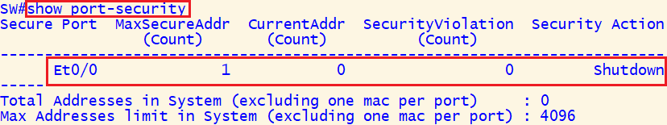
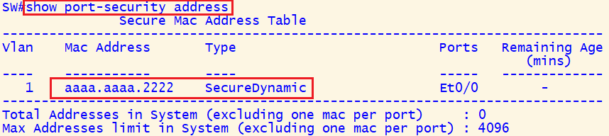
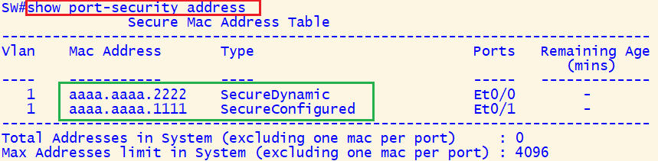
Dynamic Port Security Configuration
SW(config)#interface ethernet0/0 SW(config-if)#switchport mode access SW(config-if)#switchport port-security
SW# show port-security
SW# show port-security address
SW# show port-security interface e0/0
Static Port Security Configuration
SW(config)#interface ethernet0/1 SW(config-if)#switchport mode access SW(config-if)#switchport port-security SW(config-if)#switchport port-security mac-address aaaa.aaaa.1111
SW# show port-security
SW# show port-security address
SW# show port-security interface ethernet0/1

Slide 4
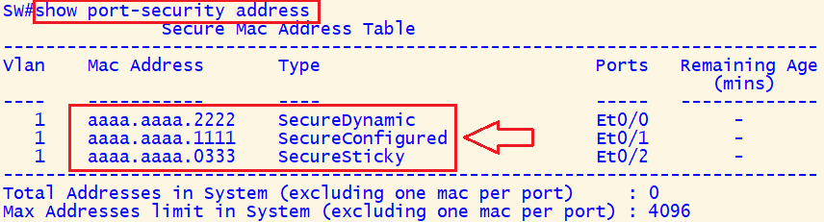
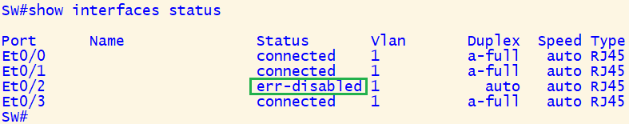
Sticky Port Security Configuration
SW(config)#interface ethernet 0/2 SW(config-if)#switchport mode access SW(config-if)#switchport port-security SW(config-if)#switchport port-security mac-address sticky
SW# show port-security
SW# show port-security address
SW# show port-security interface ethernet 0/2
Client(config)#interface ethernet 0/0 Client(config-if)#mac-address aaaa.aaaa.5555
SW(config)# interface ethernet 0/2 SW(config-if) #shutdown SW(config-if)# no shutdown
SW(config)#errdisable recovery cause psecure-violation SW(config)#errdisable recovery interval 30
SW# show interfaces status
SW# show errdisable recovery

Slide 5
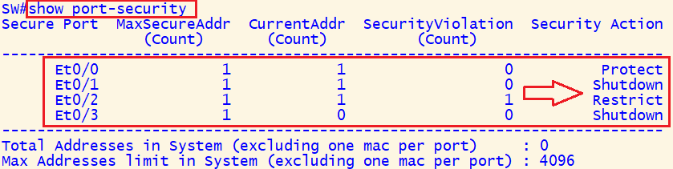
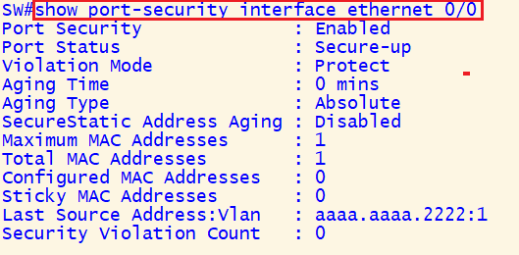
SW(config)# interface ethernet0/2 SW(config-if)#switchport port-security violation restrict SW(config-if)#switchport port-security violation protect
SW# show port-security address
SW# show port-security
SW# show port-security interface ethernet0/2
Port Security Drawbacks:
Modern hacking tools can be used to spoof MAC address & bypass this security check.
Similarly, port security does not work with dynamically configured ports in Cisco Switch.
Switch port needs to be in a static access or static trunk mode for port security to work.
802.1x is better & secure way of mitigating attacks related to layer two MAC addresses.

